Slide 1
Online Retail Data Analysis 2011
Key Insights for Strategic Growth
BY:
NACHIMUTHU CHINNADURAI

Slide 2
Agenda
Data Preparation & Cleaning
Q1: Monthly Revenue Trends (2011)
Q2: Top 10 Revenue-Generating Countries (Excl. UK)
Q3: Top 10 Customers by Revenue
Q4: Country-Level Product Demand (Excl. UK)

Slide 3
Data Preparation
Imported data into Power BI from Excel
Cleaned missing values, standardized date formats
Removed duplicates and filtered 2011 data
Created calculated fields: Revenue, Month, Country Group

Slide 4
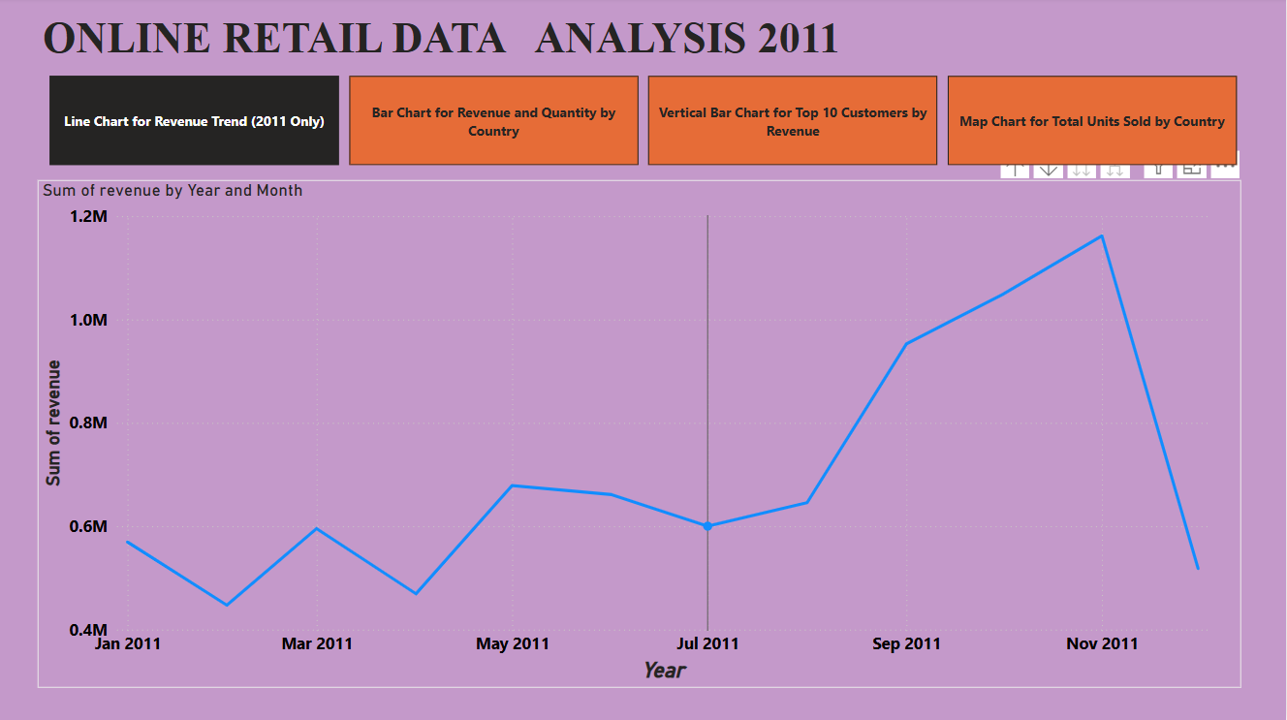
Q1 - Monthly Revenue Trends (2011)
Insight: Peaks in November and December
Possible Reason: Seasonal sales (Black Friday, Christmas)
Implication: Use this trend to forecast & optimize campaigns for Q4

Slide 5
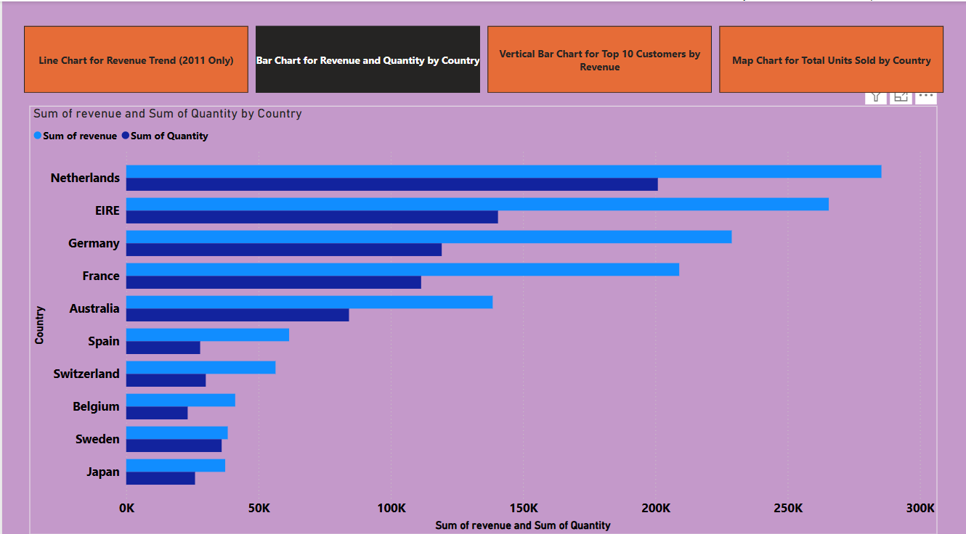
Q2 - Top 10 Countries by Revenue (Excl. UK)
Insight: Netherlands, Germany, and France among top contributors
Excluded UK for expansion focus
Implication: Explore localized strategies in these top regions

Slide 6
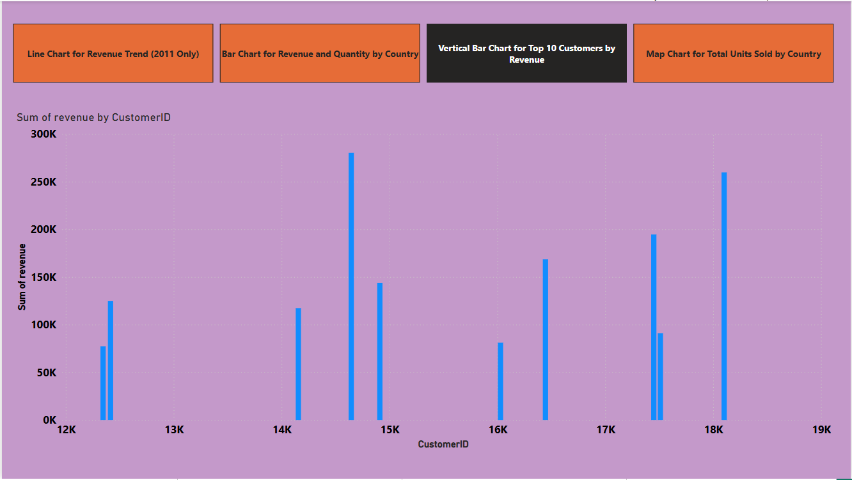
Q3 - Top 10 Customers by Revenue
Insight: Top customer alone contributed significant % of revenue
Implication: These are high-value customers – priority for retention

Slide 7
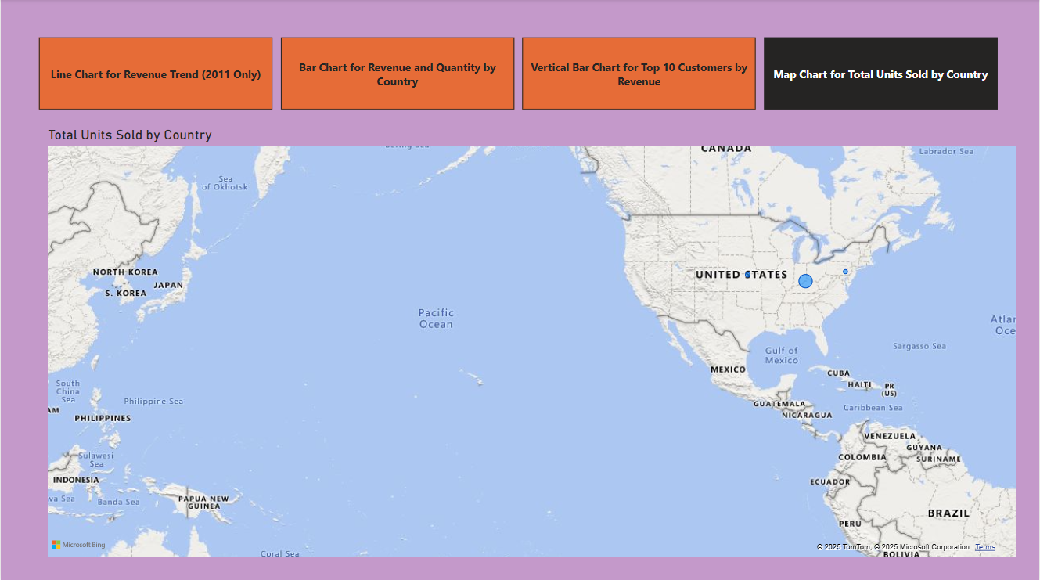
Q4 - Product Demand by Country (Excl. UK)
Insight: Germany, Netherlands, and Ireland show high demand
All in one view, no interaction needed
Implication: Identify expansion potential in high-demand countries

Slide 8
Strategic Takeaways
Q4 seasonal boost: Plan marketing & inventory ahead
Expand in non-UK countries with strong performance
Focus on top customers for loyalty & personalized marketing
Explore cross-sell and bundling in high-demand regions

Slide 9
Thank You
ANY QUESTIONS..?
Contact:
nachimuthu.nc2906@gmail.com

